Slide 1
Design and Analysis of Algorithms
Algorithms-II : CS345A
Lecture 8
Job scheduling problem (continued)
Synchronizing a circuit with minimum delay

Slide 2
A Job scheduling problem
Recap the last lecture

Slide 3





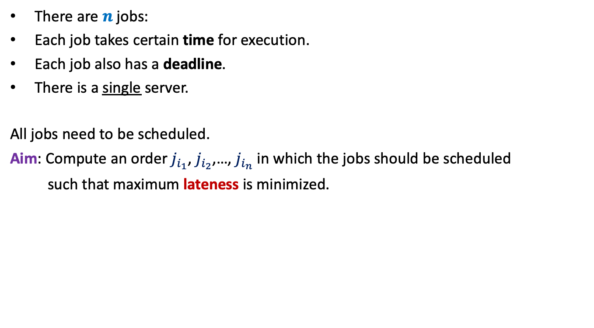








There are $n$ jobs:
Each job takes certain time for execution.
Each job also has a deadline.
There is a single server.
All jobs need to be scheduled.
Aim: Compute an order $j_{i_{1}}$, $j_{i_{2}}$,…, $j_{i_{n}}$ in which the jobs should be scheduled
such that maximum lateness is minimized.
$j_{1}$, $j_{2}$,…, $j_{n}$
Job $j_{i}$ takes $t_{i}$ time
Job $j_{i}$ has deadline $d_{i}$
$$f_{i_{k}}$$
$$d_{i_{k}}$$
$$d_{i_{k}}$$
Lateness of $j_{i_{k}}$
$$j_{i_{1}}$$
$$j_{i_{2}}$$
$$j_{i_{3}}$$
$$j_{i_{k}}$$
$$j_{i_{n}}$$
$$0$$
time

Slide 4









Scheduling 2 jobs
In the last class, we realized
Time of execution is immaterial
Lemma:(for 2 jobs)
Scheduling ``the earlier deadline job’’ ➔ an optimal solution
$$t_{1}$$
$$j_{1}$$
$$d_{1}$$
$$t_{2}$$
$$j_{2}$$
$$d_{2}$$
$$j_{2}$$
$$j_{1}$$
time
$$0$$

Slide 5
How to schedule more than 2 jobs ?
Lemma:(for 2 jobs)
Scheduling ``the earlier deadline job’’ ➔ an optimal solution
Consider any schedule
time
$$0$$

Slide 6

How to schedule more than 2 jobs ?
What if the original schedule was an optimal schedule ?
How do the jobs appear in the final schedule ?
Lemma:(for 2 jobs)
Scheduling ``the earlier deadline job’’ ➔ an optimal solution
Schedule the jobs in increasing order of their deadlines.
``jobs scheduled in the increasing order of deadline’’
is an optimal schedule
In increasing order of deadlines.
Consider any schedule
time
$$0$$
Consider any pair of consecutive jobs.
If they are not scheduled in the increasing order of their deadlines,
swapping them will only minimize the maximum lateness of the schedule
By repeating this step for each pair of consecutive jobs,
we can transform the schedule into a schedule
whose maximum lateness is less than or equal to that of the original schedule.
Algorithm:
$O(n log⁡n)$ time

Slide 7
Synchronizing a circuit
with minimum delay enhancement

Slide 8
An Electric Circuit
A complete binary tree
Electric signal originates at the root
Signal passing through each edge incurs a delay (a few nano seconds)
Finally signal reaches all the leaves.
Electric signal
6
5
3
2
4
2
2
1
6
2
1
2
3
2
Delay 11 10 14 10 10 11 10 9
14
10

Slide 9
Problem definition
Given:
There is a circuit in the form of a complete binary tree.
Electric signal propagates from root to all leaf nodes.
Each edge has certain delay
The delay in reaching signal to a leaf node =
“sum of delays on all edges on the path from root.”
Objective:
Enhance delay along certain edges so that
The delay on all paths from root to leaf nodes is the same.
Total delay enhancement is minimum.
What is the first step for designing an algorithm ?

Slide 10
Working on an Example

Slide 11
Working on an Example
+4 is necessary
How to achieve 1st Objective:
Synchronizing all paths from the root?
What algorithm comes to your mind based on this inference ?
Electric signal
Spend some time on this portion to see if you can reduce the total delay ?
Total delay enhancement: 27
6
5
How much enhancement is needed for this edge ?
3
2
4
2
2
1
6
2
+4
1
2
3
2
+3 +4 +4 +3 +4 +5
Delay 11 10 14 10 10 11 10 9
New Delay 14 14 14 14 14 14 14 14
Is this the minimum delay enhancement ?

Slide 12




Working on an Example
What algorithm comes to your mind based on this inference ?
Electric signal
Total delay enhancement: 27
Recall from the past slide +4 is necessary for $v$.
+1 is necessary for $u$.
6
5
3
2
4
2
+4
$$v$$
$$u$$
2
1
6
2
1
2
3
2
+3 +4 +4 +4 +3 +1
Delay 11 10 14 10 10 11 10 9
New Delay 14 14 14 14 14 14 14 14
➔ 23

Slide 13
Toward designing an algorithm
Electric signal
Total delay enhancement: 14
6
5
+3
3
+3
2
4
2
+1
2
6
+4
1
1
2
+1
3
2
+1
+1
2
14
11
14
14
14 14 14 14
11
11
Delay 11 10 14 10 10 11 10 9
11
10
For nodes just above the leaf level
What about the nodes at higher levels ?
Inspired by the processing done at the lower levels,
the following seems to be the way to process higher nodes.
All this enhancement was absolutely necessary.

Slide 14
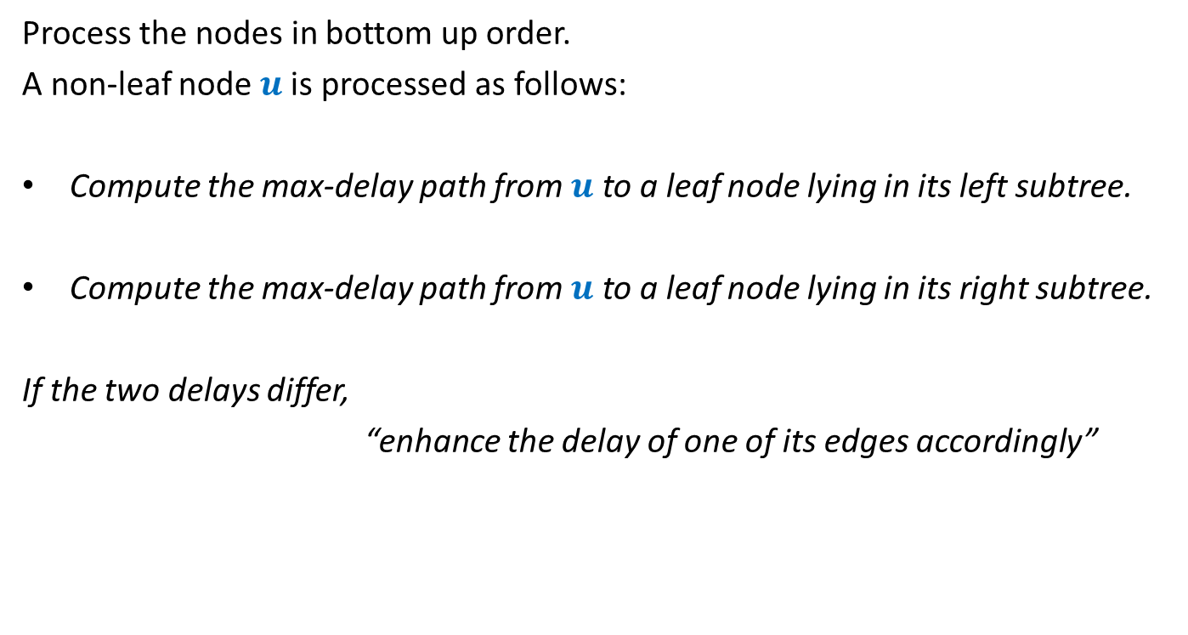
Overview of the proposed algorithm
Process the nodes in bottom up order.
A non-leaf node $u$is processed as follows:
Compute the max-delay path from $u$ to a leaf node lying in its left subtree.
Compute the max-delay path from $u$ to a leaf node lying in its right subtree.
If the two delays differ,
“enhance the delay of one of its edges accordingly”
We need to describe this step more formally. ☺

Slide 15








For each non-leaf node $u$ do the following:
$D_{L}(u)$: max delay along any leftward path
$D_{R}(u)$: max delay along any rightward path
If ($D_{L}\left(u\right)≥D_{R}(u)$)
increase delay of right edge by $D_{L}\left(u\right)$ - $D_{R}\left(u\right)$
Else
increase delay of left edge by $D_{R}\left(u\right)$ - $D_{L}\left(u\right)$
$$γ$$
u
$$α$$
$$β$$
$$+D_{R}\left(u\right)\text{ − }D_{L}\left(u\right)$$
$$+D_{L}\left(u\right)\text{ − }D_{R}\left(u\right)$$
$$D_{L}(u)$$
$$D_{R}(u)$$

Slide 16
Proof of correctness of the algorithm
What assertion suffices as a proof ?

Slide 17
What assertion suffices as a proof ?
Usually it is difficult even to find out the claim whose establishment captures the correctness of the algorithm.☹
In the current algorithm, what might be this claim ?
Let us have a re-look at the algorithm from point of view of a single node .

Slide 18
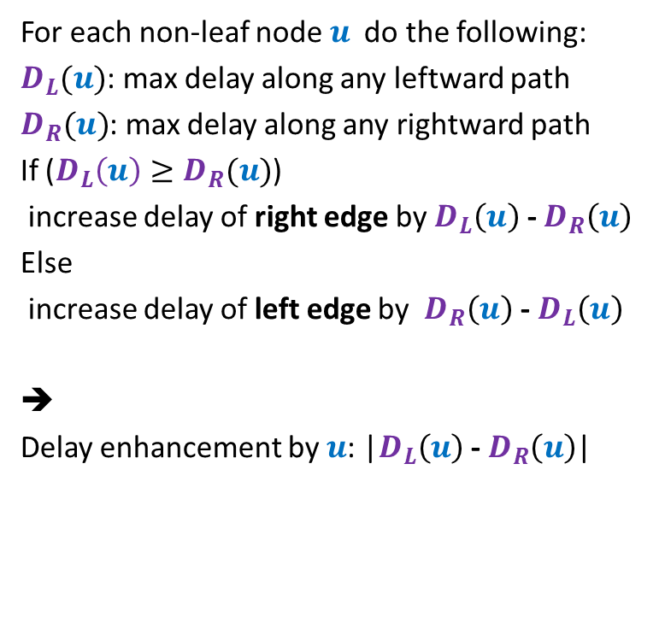



For each non-leaf node $u$ do the following:
$D_{L}(u)$: max delay along any leftward path
$D_{R}(u)$: max delay along any rightward path
If ($D_{L}\left(u\right)≥D_{R}(u)$)
increase delay of right edge by $D_{L}\left(u\right)$ - $D_{R}\left(u\right)$
Else
increase delay of left edge by $D_{R}\left(u\right)$ - $D_{L}\left(u\right)$
➔
Delay enhancement by $u$: |$D_{L}\left(u\right)$ - $D_{R}\left(u\right)$|
$$γ$$
u
$$α$$
$$β$$
$$+D_{L}\left(u\right)\text{ − }D_{R}\left(u\right)$$
$$D_{L}(u)$$
$$D_{R}(u)$$

Slide 19
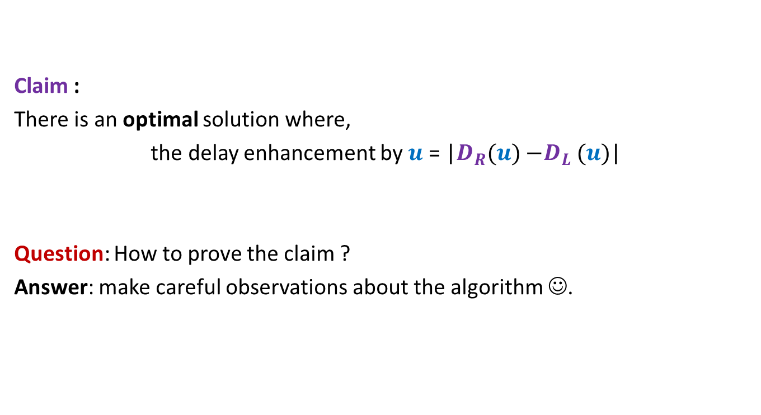
Claim :
There is an optimal solution where,
the delay enhancement by $u$ = |$D_{R}(u){−D}_{L}(u)$|
Question: How to prove the claim ?
Answer: make careful observations about the algorithm ☺.

Slide 20




Observation 1
Electric signal
Root is synchronized in the optimal solution.
Question: What can we say about the synchronization of any node in the optimal solution?
Answer: Every node must be synchronized.
(proof by contradiction: append the path from root to $u$ to get two paths with different delays.)
$$u$$
$$δ_{1}$$
$$δ_{2}$$

Slide 21
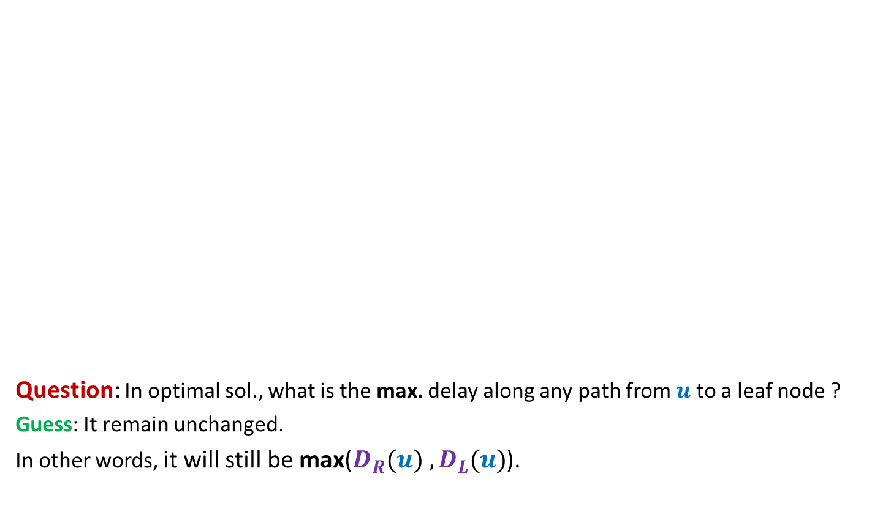
Observation 2
The maximum delay from the root to any leaf node remains unchanged in the optimal solution. What can we say about the maximum delay from any other node to any leaf node in its subtree?
Electric signal
Question: In optimal sol., what is the max. delay along any path from $u$ to a leaf node ?
Guess: It remain unchanged.
In other words, it will still be max($D_{R}(u){ ,D}_{L}(u)$).
$$u$$
6
5
+3
3
+3
2
4
2
+1
2
6
+4
1
1
2
+1
3
2
+1
+1
2
Delay 11 10 14 10 10 11 10 9
New Delay 14 14 14 14 14 14 14 14

Slide 22
Usefulness of the guess

Slide 23
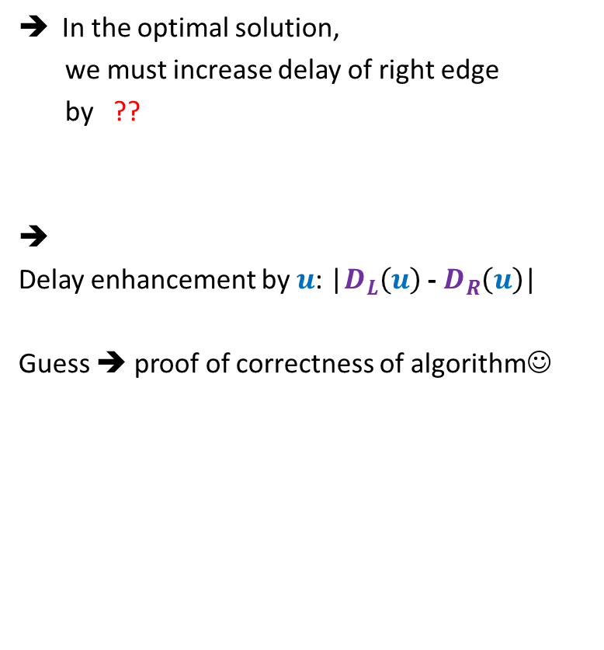



Usefulness of the guess
Suppose $D_{L}(u){≥D}_{R}(u)$
In the optimal solution,
we must increase delay of right edge
by ??
➔
Delay enhancement by $u$: |$D_{L}\left(u\right)$ - $D_{R}\left(u\right)$|
Guess ➔ proof of correctness of algorithm☺
How much enhancement ?
$$γ$$
How much enhancement ?
$D_{L}\left(u\right)$ - $D_{R}\left(u\right)$
u
$$α$$
$$β$$
0
$$+D_{L}\left(u\right)\text{ − }D_{R}\left(u\right)$$
$$D_{L}(u)$$
$$D_{R}(u)$$
unchanged
unchanged

Slide 24

Proving the guess
Guess : In the optimal solution, the delay along any path from $u$ to any leaf node is max($D_{R}(u){ ,D}_{L}(u)$).
Question: How to prove it ?
Answer: By contradiction.

Slide 25
What if the assertion fails at many nodes ?
Homework: Make sincere attempt to get proof by contradiction.

